Slide 1



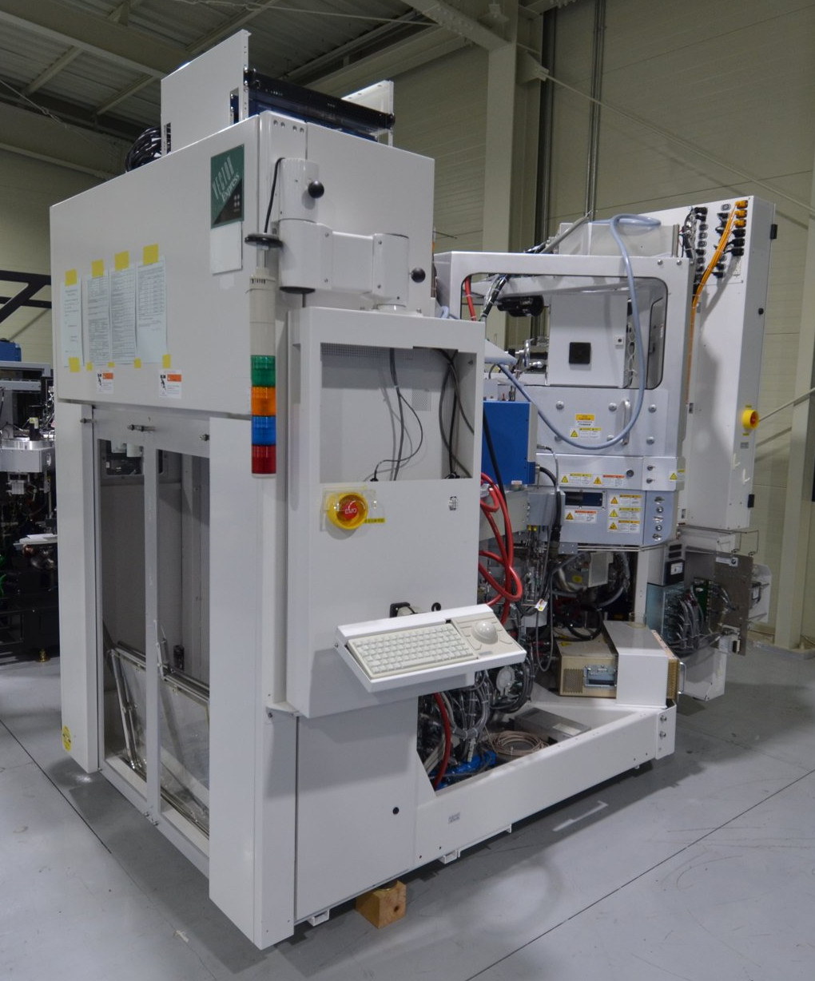
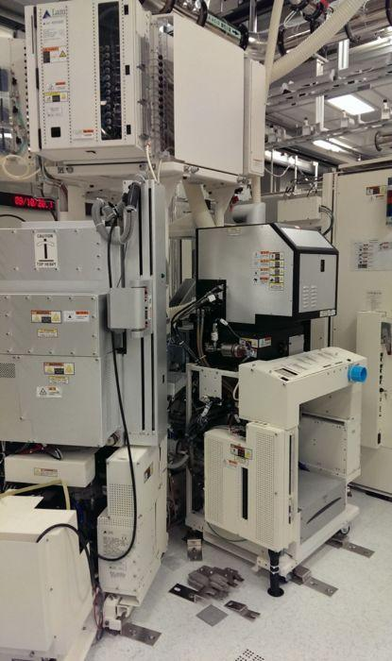




Lam Research Etcher Tools, Service, Upgrades, Projects & Training
817.946.5076
817.733.8162
Lam Services
Refurbished “as-new” tools with installation, start-up, warranty, and training
Legacy stand-alone tools, Alliance and 2300 platforms fully supported
Tool reconfigurations and upgrades (e.g. computer upgrade)
Tool deinstallations, relocations and installations
Envision computer upgrade
Refurbishment Facilities in Austin, TX and Korea
Large Lam parts and consumable spares inventory
Ten regular full time LAM FSEs on staff
Orbital Welding facilities in our Austin and Korean facilities
Advantages of Using a The IQW Group and One Semiconductor
1. Cost Efficiency
  Lower Operational Costs: On-site support is more cost-effective than relying on OEM, particularly for older equipment that no longer benefits from OEM warranties or support.
  Reduced Replacement Costs: Legacy tools may no longer be supported by the OEM, and we extend the life of these tools,.
2. Extended Equipment Lifespan
  Maintenance and Repair: We provide upgrades, specialized maintenance and repair services, which can extend the life of legacy tools beyond the original OEM's support timeframe at significant cost savings.
  Part Availability: They often maintain or have access to spare parts that OEMs may no longer manufacture, keeping the legacy equipment functional.
3. Specialized Expertise
  Legacy Tool Expertise: Our team of FSEs focus on legacy tools, with deep expertise that may even surpass the OEM's current focus, particularly for older models.
  Customized Solutions and Upgrades: We provide tailored service packages and upgrades that are designed to address the specific needs of older tools.
4. Faster Response Time
  Quicker Support: We offer faster turnaround times for support requests keeping your legacy tools operational.
  Local/Regional Presence: We have local or regional presence that allows for more immediate support, reducing downtime.
About Us
The IQW Group has been supporting the semiconductor industry with value-added services for over 30 years. We are a manufacturer’s representative, distributor, reseller and remarketer for process tools and critical parts. We also support our customers with refurbishing services, repair services, turnkey projects and labor resources. Our expertise in supporting the global semiconductor manufacturing market allows us to be highly flexible to meet our customers’ needs.
www.iqwinc.com
sales@iqwinc.com

